Slide 1

CHE 101L
General Chemistry
Lab
Monzil Hossain
BS in Chemistry (New York University, USA), MS in Chemical Engineering (Columbia University, USA)
Lecturer
Department of Biochemistry and Microbiology
School of Health & Life Sciences
monzil.hossain@northsouth.edu
Office Hours: Thursday 9.30 AM – 10.30 AM (Room SAC 1164)

Slide 2
CHE 101L
Chemical Bonding &
Molecular Shape
Expt 2: Chemistry Model Kit System: Chemical Bonding & Molecular Structures
Determination of Lewis Dot structures and visualization of the shapes of molecules using valence shell electron pair repulsion theory (VSEPR theory). These topics are typically covered in the “Chemical Bonding” and “Molecular Geometry”.
In this laboratory period, determine the Lewis Structures and the three dimensional geometries of molecular species starting only with molecular formulas. Thus, there will be no wet lab work, per se.

Slide 3
CHE 101L
Chemical Bonding &
Molecular Shape
Model kits (in this case, a model of any atom from Styrofoam balls and toothpicks as connecting bonds) will be available so that the students can construct three-dimensional (3D) models of the molecules. Students will determine the shape of molecules and build a 3D model of those contained in an assigned list of candidate molecular species.
Pre-Lab Assignment: Prior to the lab, students should study the sections of the textbook on chemical bonding, i.e., Lewis structures and molecular geometries (VSEPR, valence shell electron pair repulsion theory)
Pre-requisite Knowledge:
Covalent bonding; II. Drawing valid Lewis structures for molecular compounds; III. Electrostatic repulsive forces;
IV. Valence shell electron pair repulsion theory(VSEPR)

Slide 4
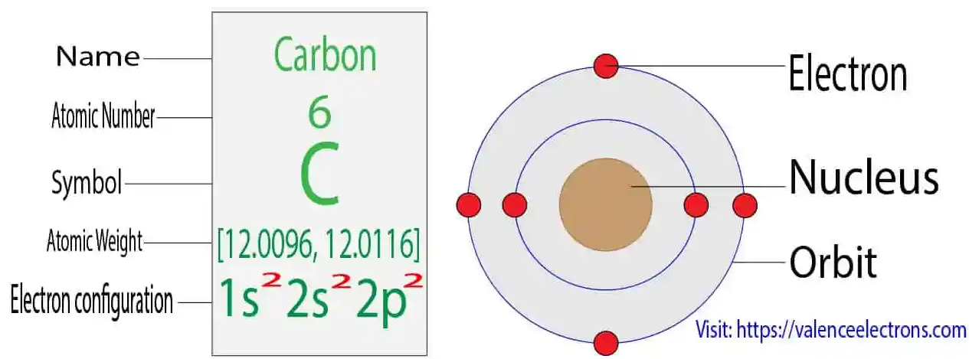
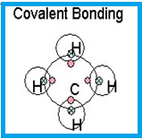
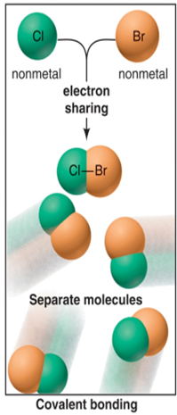
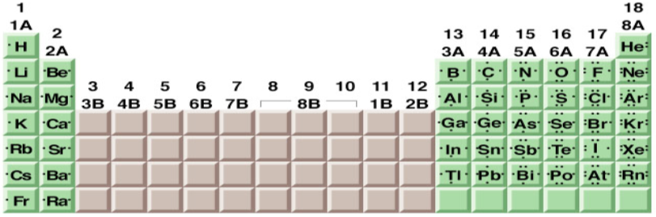
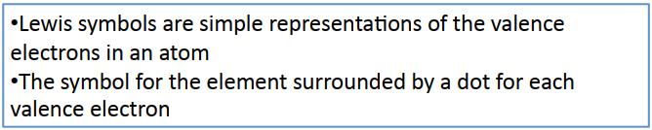
CHE 101
Chemical Bonding &
Molecular Shape
Chemical bond: an attractive force that allow atoms to be closely associated
COVALENT BOND: Sharing of electrons between two atoms.

Slide 5
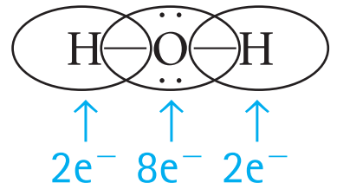
The F₂ Molecule
The O₂ Molecule
CHE 101
Chemical Bonding &
Molecular Shape
F F
O O
An octet achieved by left fluorine
An octet achieved by right fluorine
An octet for the left oxygen
An octet for the right oxygen
••
••
••
••
F
F
or
F–F
••
••
••
••
••
••
••
••
••

Slide 6
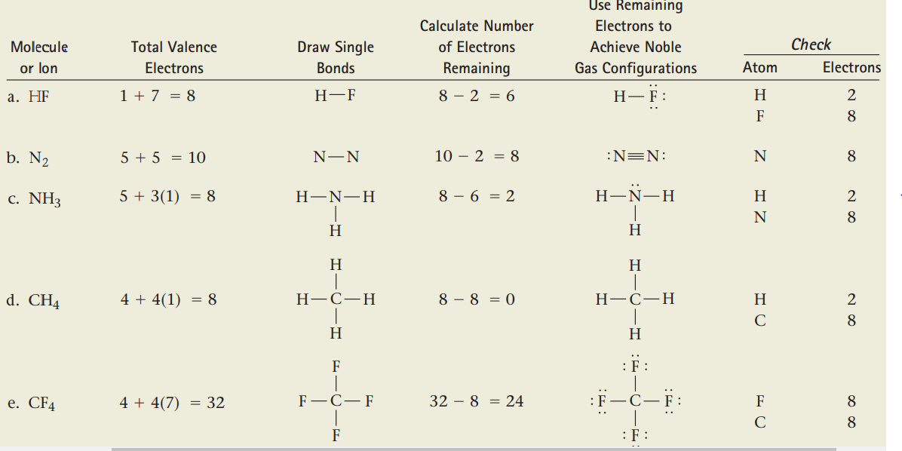
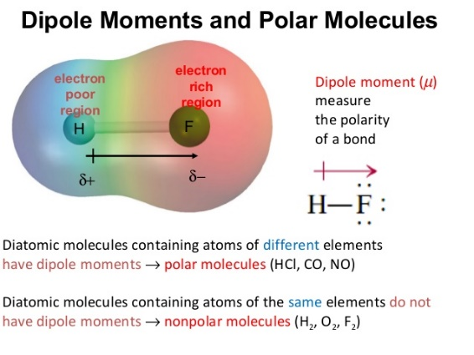

CHE 101
Polarity in Covalent Bonds
H
H
F
F
A polar covalent bond

Slide 7
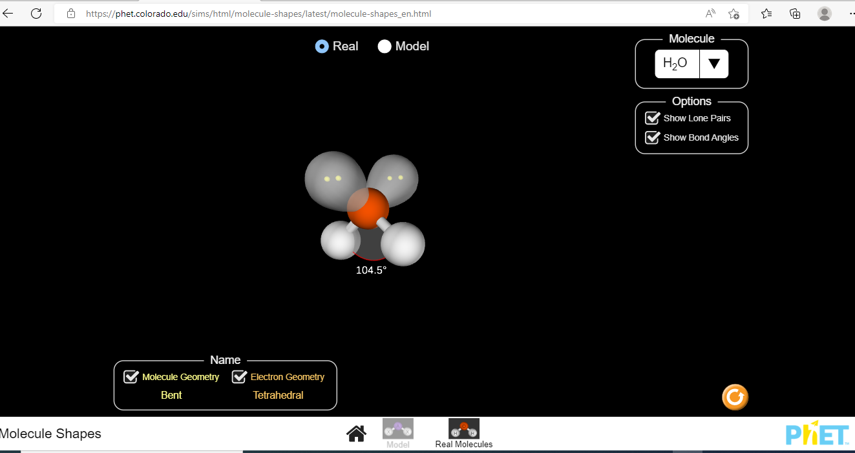
CHE 101L
Molecular Shape
PhET simulation Activity Used:
Molecular Shapes: https://phet.colorado.edu/en/simulation/molecule-shapes

Slide 8
CHE 101L
Molecular Shape
Special equipment and chemicals needed for the class:
a. Styrofoam balls (Color Coded) b. Toothpicks
Procedure:
For this lab, PhET interactive simulations (https://phet.colorado.edu/en/simulation/molecule-shapes) will be used to revisit Lewis Structures and VSEPR geometry understanding.
After practicing with the models and other tools, students will work some of the examples for Lewis Structures without the use of model kits or simulation software so they can learn how to write them out by hand. The step-by-step procedure is as follows:
Distribute the worksheet to students to complete the valence electron count, Lewis structure, and formal charge columns.
Students work in groups to complete (with the help of Table 1) the columns for the next 5 examples given below. Those answers will be reviewed together.

Slide 9
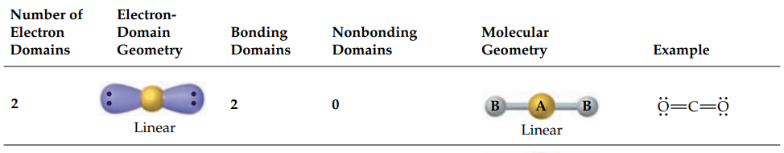
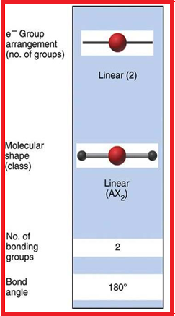
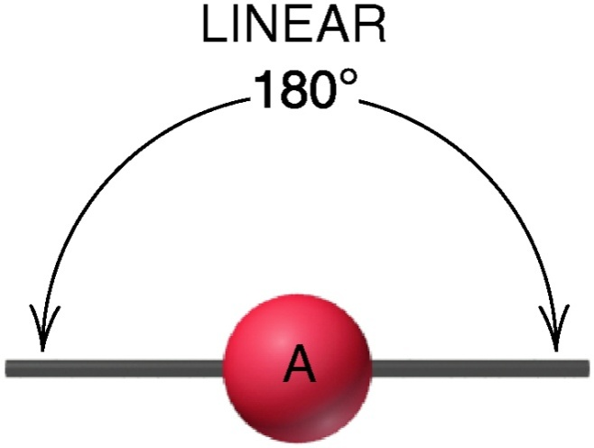
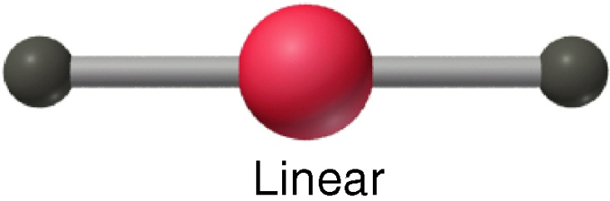
CHE 101
Molecular Shapes with Two Electron Groups
AX₂
Examples:
CS₂, HCN, BeF₂, CO₂
Electronic Geometry

Slide 10
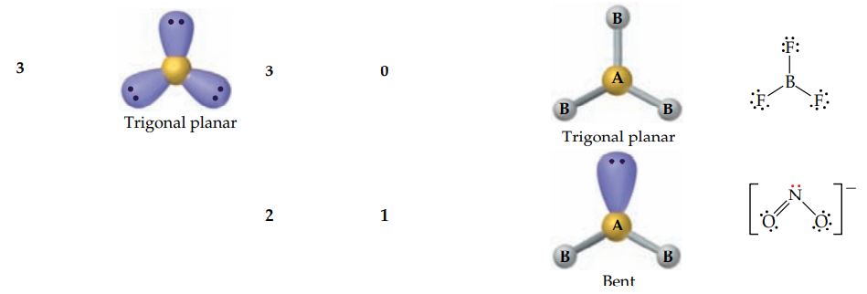
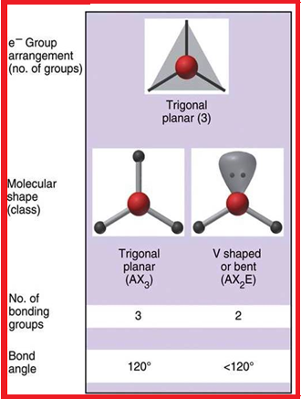
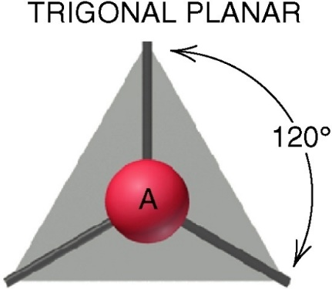
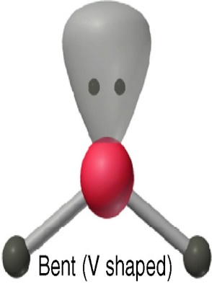
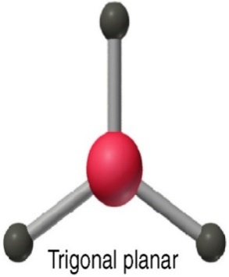
CHE 101
Molecular Shapes with Three Electron Groups
AX₃
AX₂E
Examples:
SO₃, BF₃, NO₃–, CO₃^{2–}
Examples:
SO₂, O₃,
PbCl₂, SnBr₂
Electronic Geometry

Slide 11
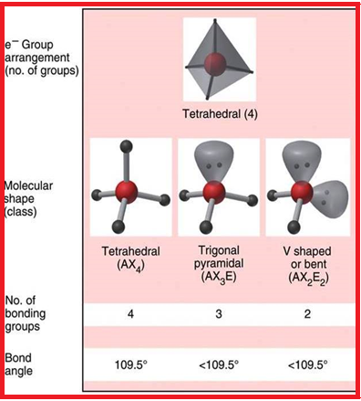
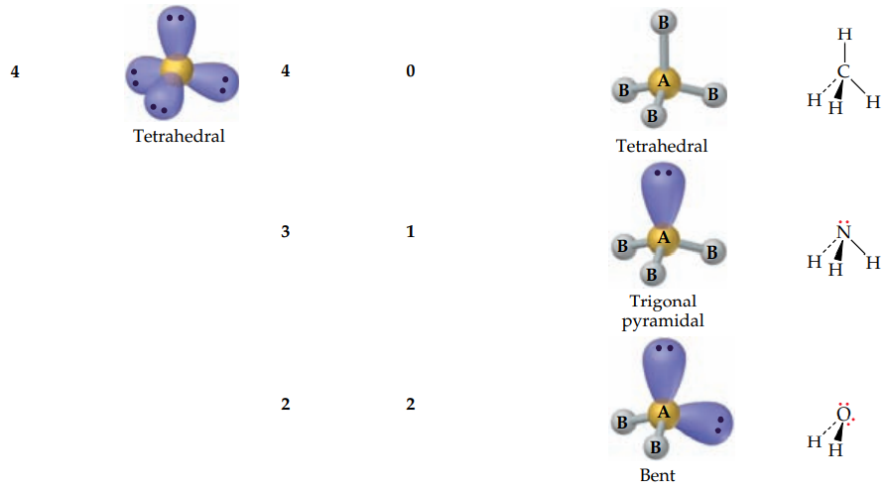
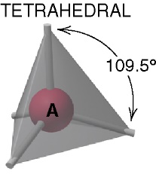
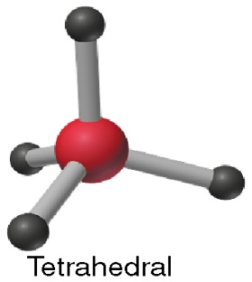
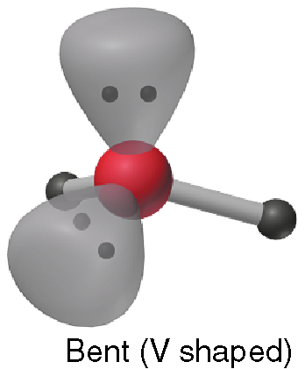
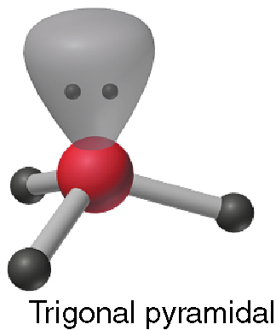
CHE 101
Molecular Shapes with Four Electron Groups
Electronic Geometry
Examples:
CH₄, SiCl₄, SO₄^{2–}, ClO₄–
AX₄
AX₂E₂
AX₃E
Examples:
H₂O, OF₂, SCl₂
Examples:
NH₃, PF₃
ClO₃–, H₃O⁺

Slide 12
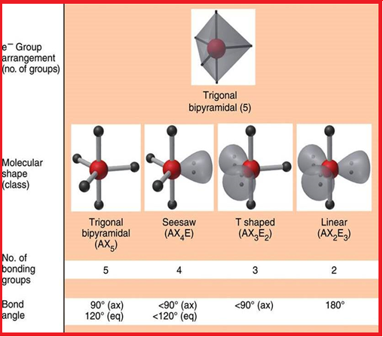
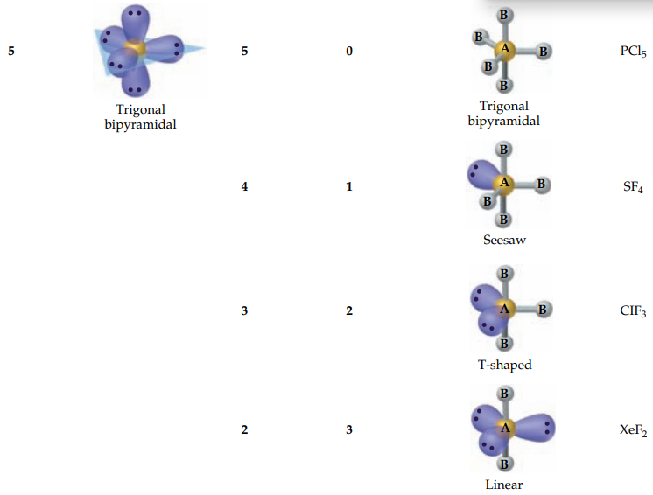
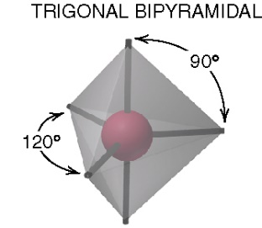
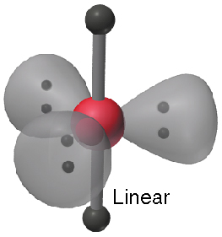
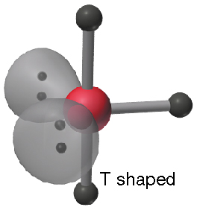
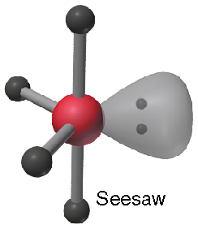
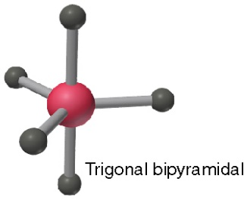
CHE 101
Molecular Shapes with Five Electron Groups
Electronic Geometry
AX₃E₂
AX₂E₃
Examples:
ClF₃, BrF₃
AX₅
Examples:
PF₅, AsF₅,
SOF₄
AX₄E
Examples:
SF₄, XeO₂F₂
IF₄⁺, IO₂F₂–
Examples:
XeF₂, I₃–, IF₂–

Slide 13
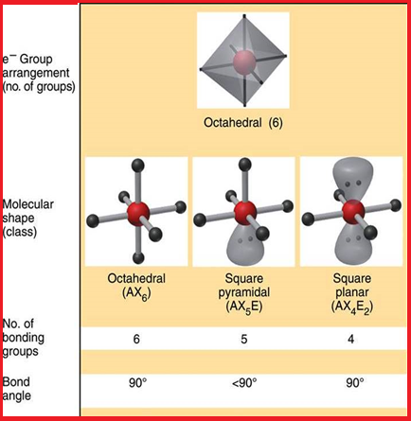
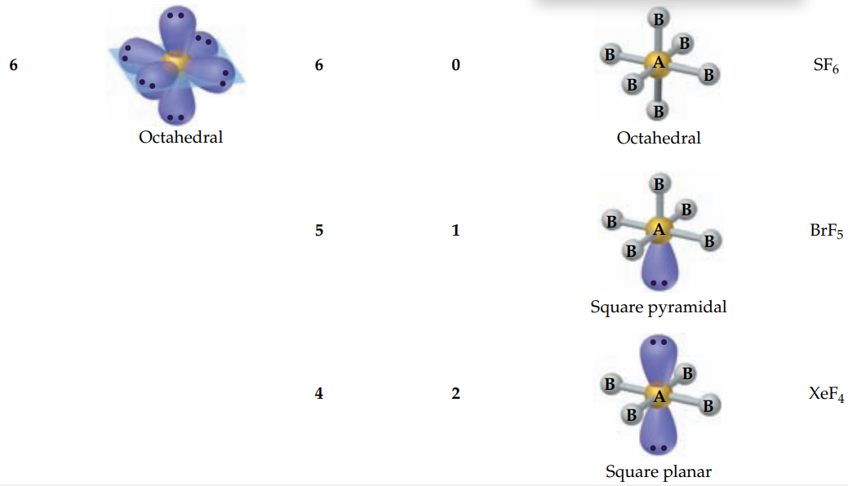
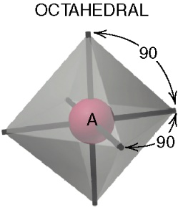
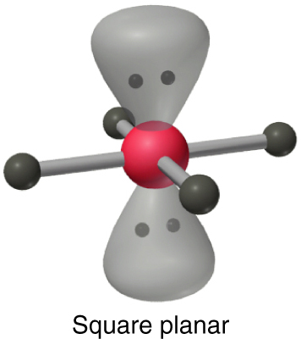
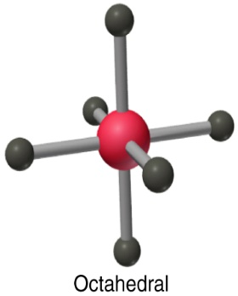
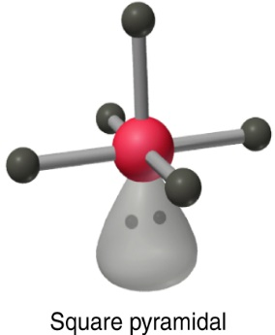
CHE 101
Molecular Shapes with Six Electron Groups
Electronic Geometry
AX₄E₂
AX₆
AX₅E
Examples:
BrF₅, TeF₅–,
XeOF₄
Examples:
SF₆, IOF₅
Examples:
XeF₄, ICl₄–

Slide 14
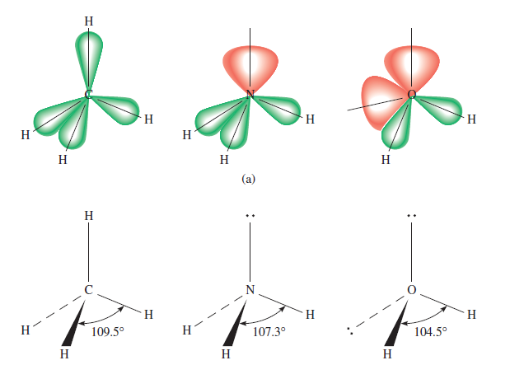
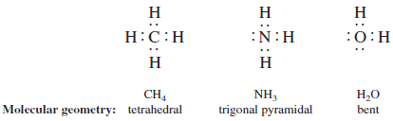
CHE 101
Molecular Shapes & VSEPR

Slide 15
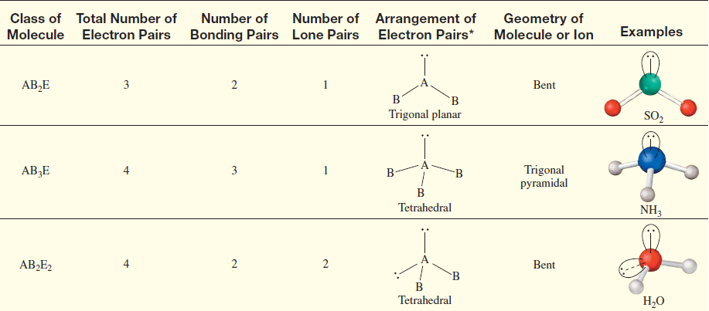
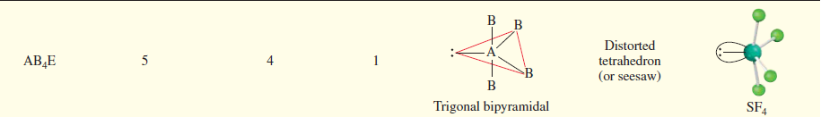
CHE 101
Molecular Shapes & VSEPR

Slide 16
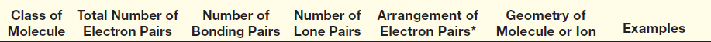
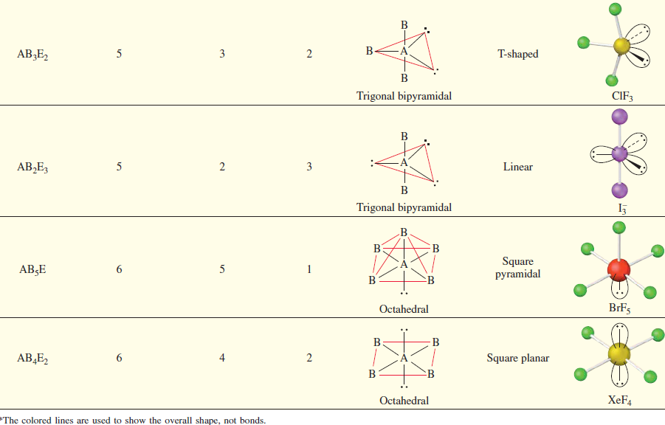
CHE 101
Molecular Shapes & VSEPR

Slide 17
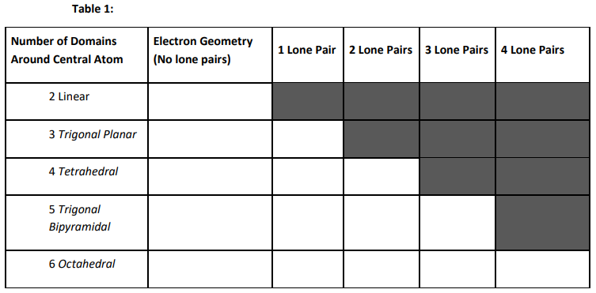
CHE 101
Molecular Shapes & VSEPR

Slide 18
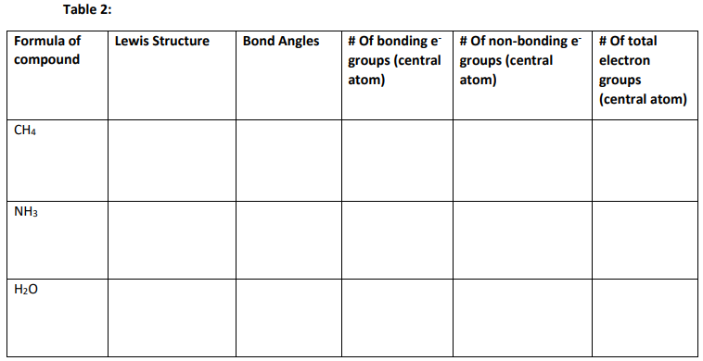
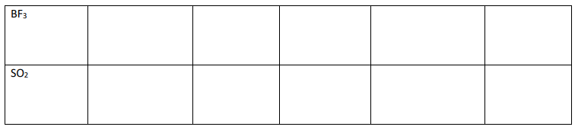
CHE 101
Molecular Shapes & VSEPR

Slide 19
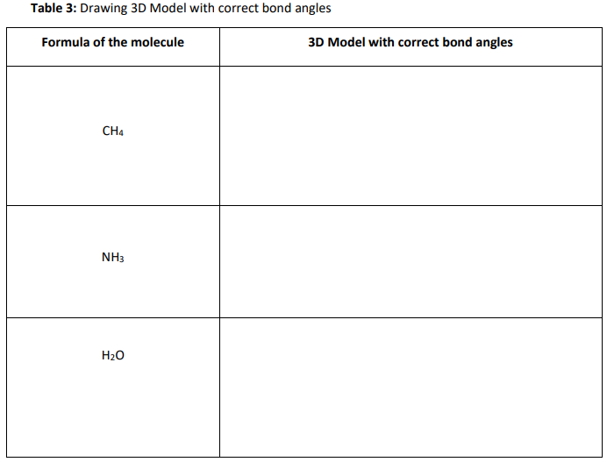
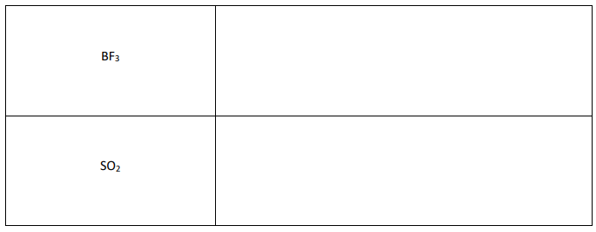
CHE 101
Molecular Shapes & VSEPR
VSEPR Theory is introduced here using the PhET “Molecule Shapes Interactive Simulation”1 (https://phet.colorado.edu/en/simulation/molecule-shapes). Students should have devices with internet access (preferably through cell phones) for this is a guided activity that introduces students to valence shell electronic pair repulsion theory (VSEPR). It is a group/computer-based activity that takes a few minutes. Students will work in groups and complete the activity sheet.

Slide 20




